Slide 1



Finding personality groups using the big five personality traits and clustering

Slide 2
Big five personality traits: Brief history
Most commonly known and accepted models in psychology.
Proven in psychology factor analysis from personality questionnaires can best describe someone.
Known as the big five because deemed the traits able to tell us the most about a person.
Big Five originated in 1992.

Slide 3
Big five personality traits: What are they?
Extraversion
the personality trait of seeking fulfillment from sources outside the self or in community. High scorers tend to be very social while low scorers prefer to work on their projects alone.
Neuroticism
the personality trait of being emotional.
Conscientiousness
the personality trait of being honest and hardworking. High scorers tend to follow rules and prefer clean homes. Low scorers may be messy and cheat others.

Slide 4
Big 5: what are they?...Continued
Agreeableness
reflects how much individuals adjust their behavior to suit others. High scorers are typically polite and like people. Low scorers tend to tell it like it is.
Openness to Experience
the personality trait of seeking new experience and intellectual pursuits. High scores may daydream a lot. Low scorers may be very down to earth.

Slide 5
Dataset info
Kaggle data set
Personality questionnaire
Using the big 5 personality markers
Over 1 million records before data cleaning
Other unnecessary info that would be removed

Slide 6
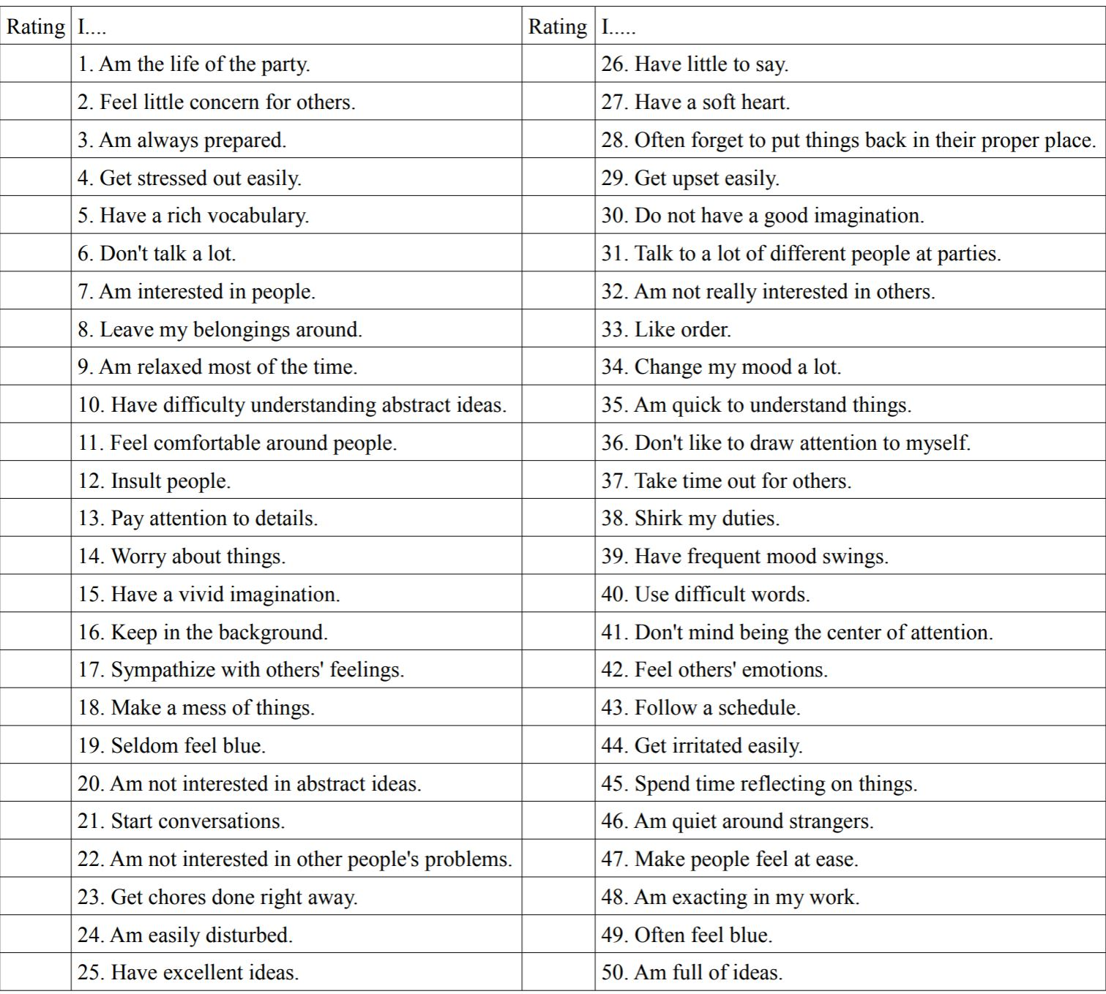

Slide 7
Data continued
Responses to the questions
1 = disagree
2 = slightly disagree
3 = neutral
4 = slightly agree
5 = agree

Slide 8
Data cleaning
Removed all invalid responses:
Zeroes
Anything greater than 5
Left blank
Total records after cleaning: ~ 700k
Removed unnecessary info:
Country, date taken, etc.

Slide 9
Data exploration
Graphs total results to look for any trends before clustering techniques

Slide 10
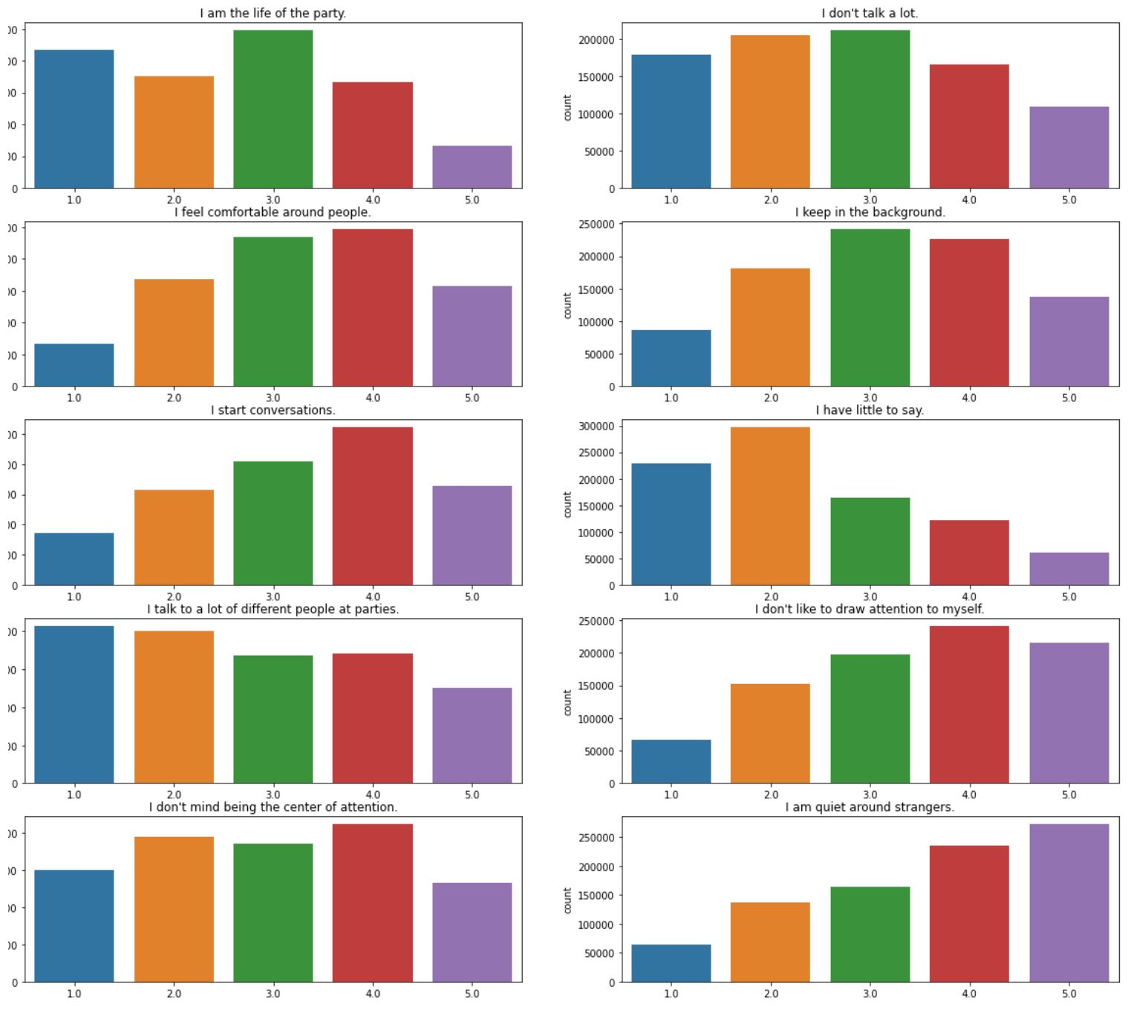
extraversion
Conclusions:
People tend to be comfortable starting conversations but will not talk to a lot of different people at parties.

Slide 11
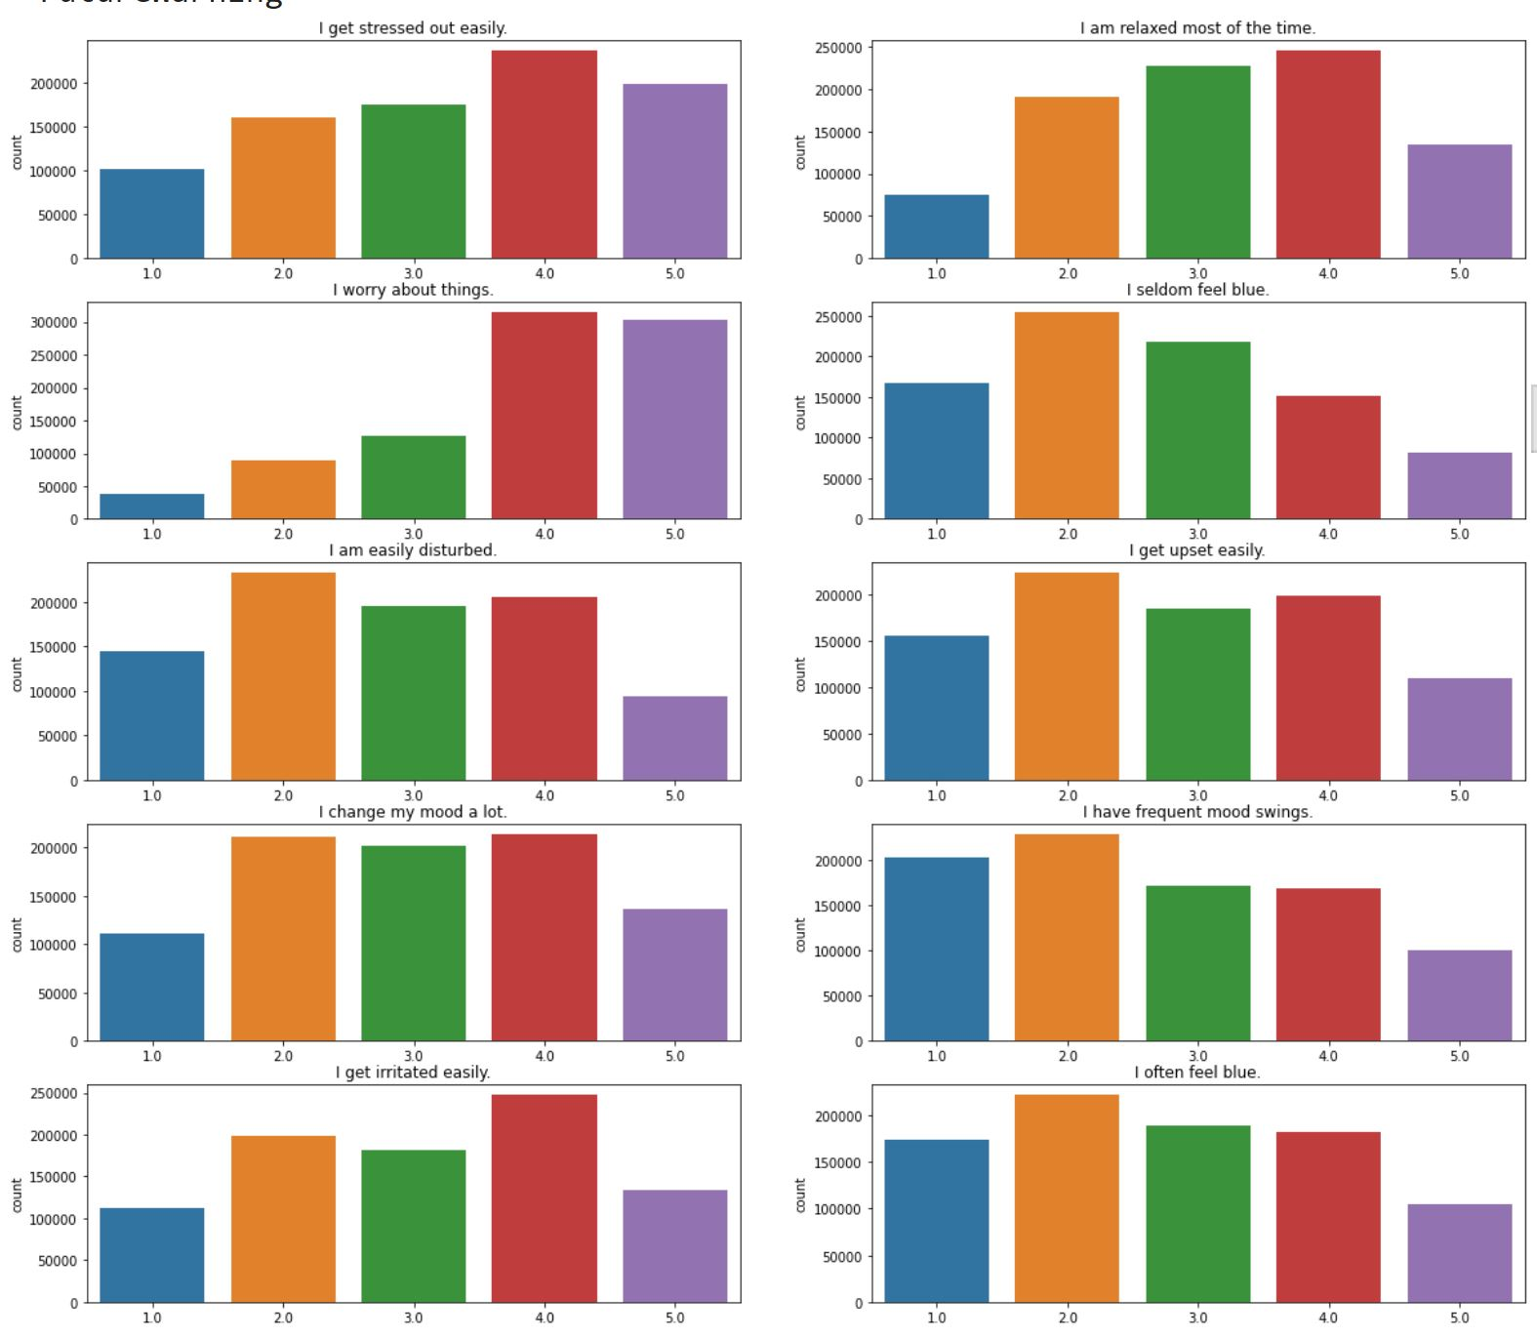
Neuroticism
Conclusions:
Majority of people get stressed and tend to worry about things.

Slide 12
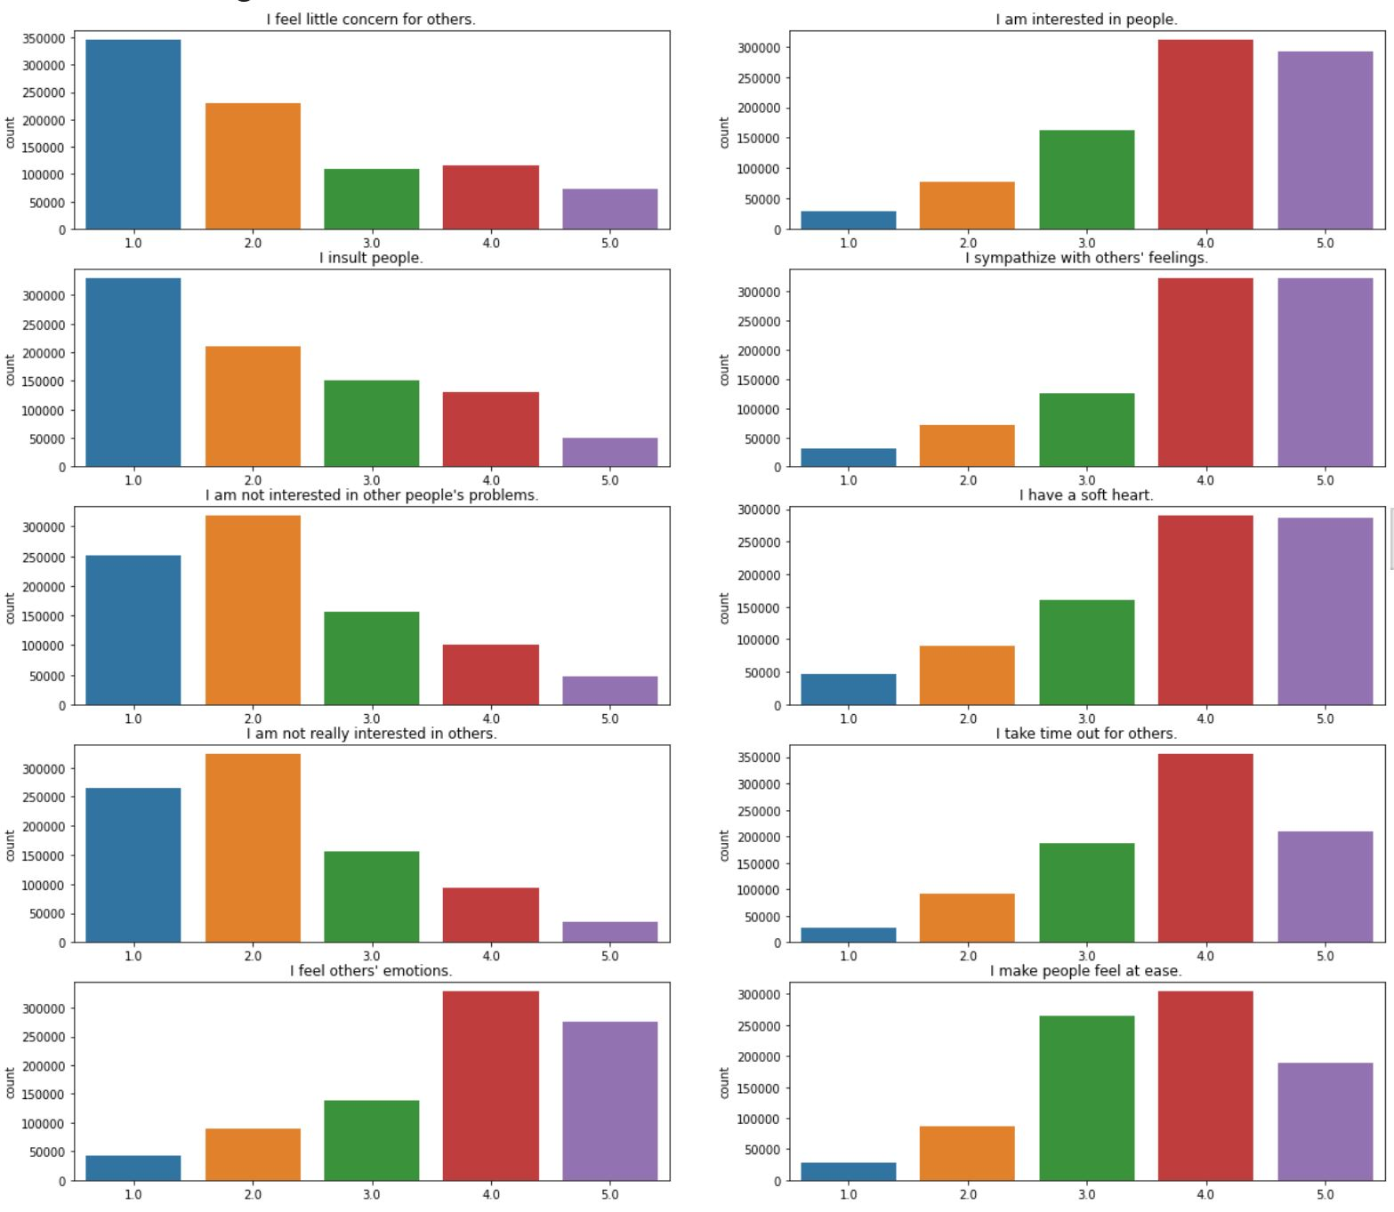
Agreeableness
Conclusions:
Majority tend to care for others and are interested in people, while most people also tend to sympathize with others’ feelings

Slide 13
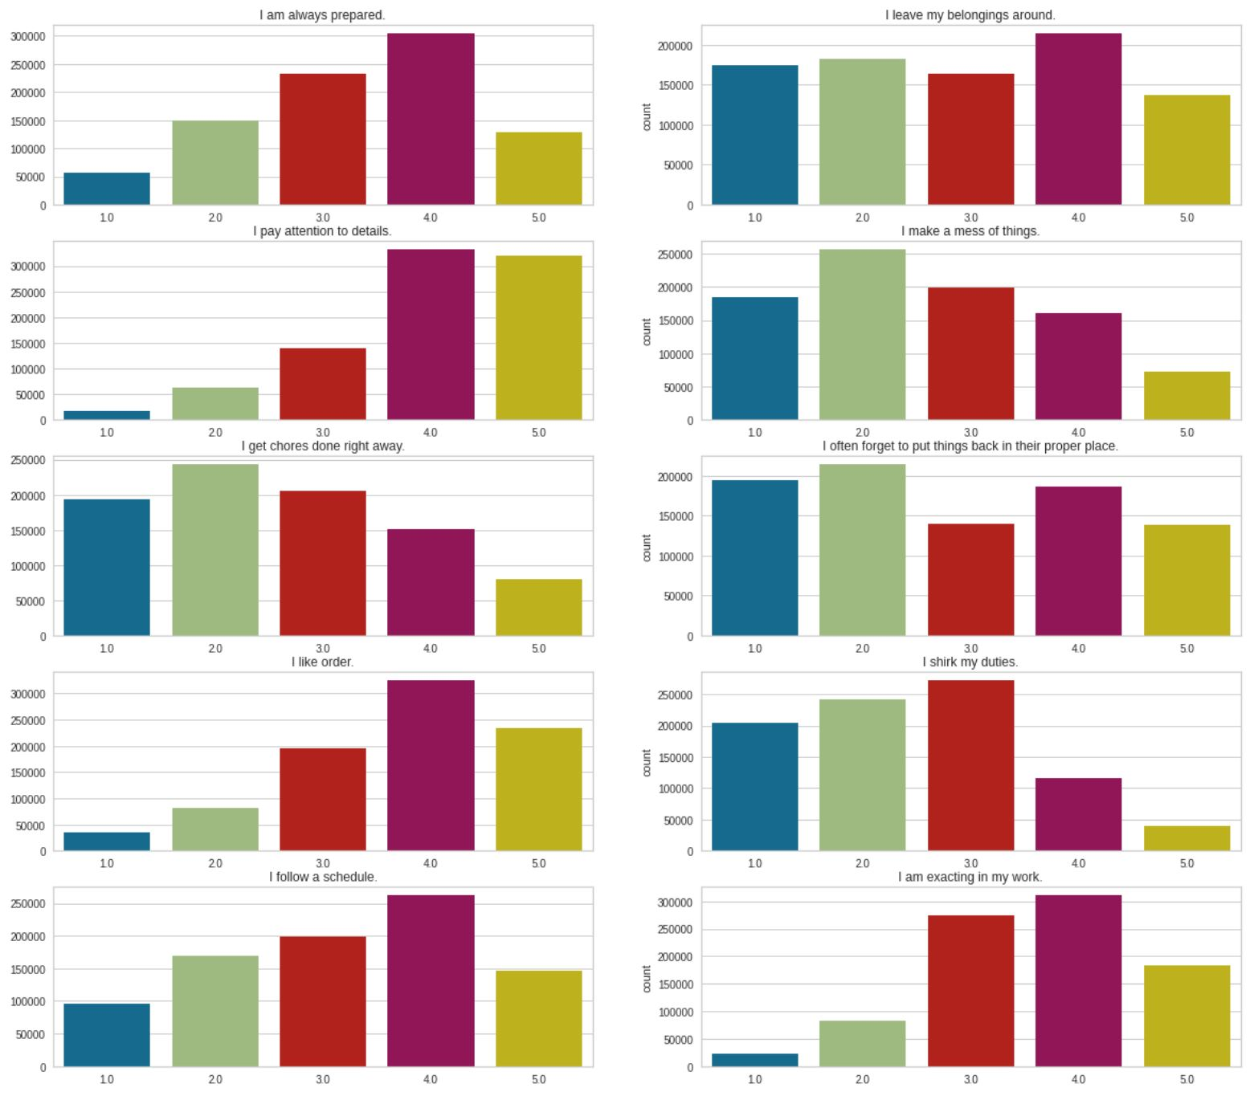
Conscientiousness
Conclusions:
These results are a bit more scattered, but it can be seen that a majority of people pay attention to details.

Slide 14
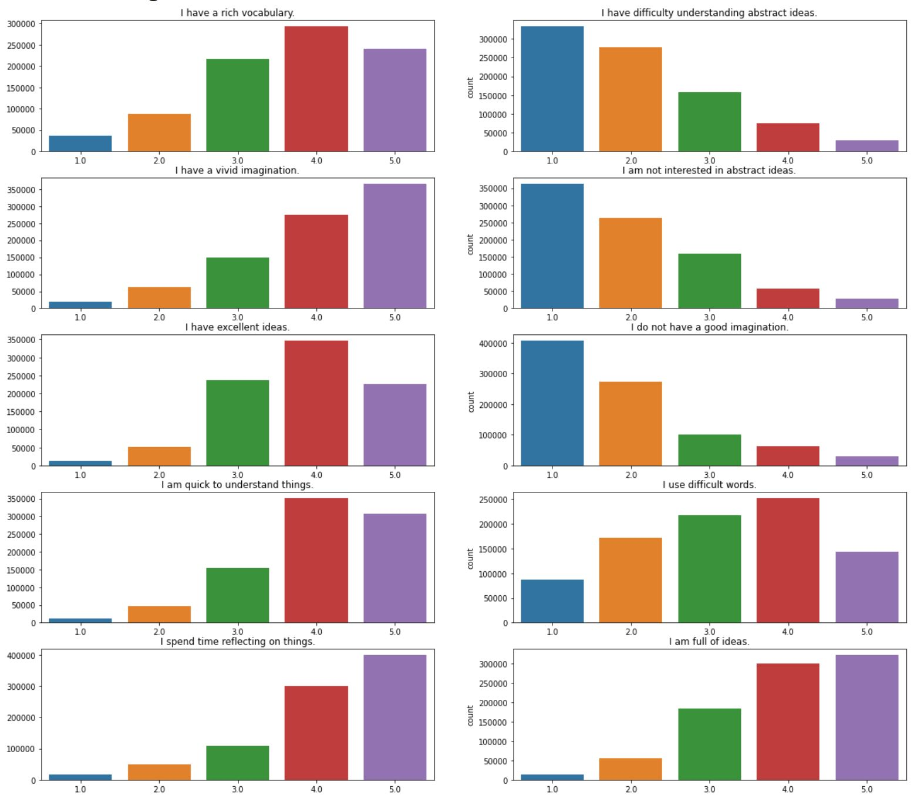
Openness to experience
Conclusions:
Questions 2, 4, and 6 all have very similar results. As well as almost every result in this category are linear.

Slide 15
Methodology: Clustering
K-Means clustering
Goal:
Will any clusters stick out from the rest in the results?
Not expected due to large sample size and small range of possible answers…..but the results may be a little surprising.

Slide 16
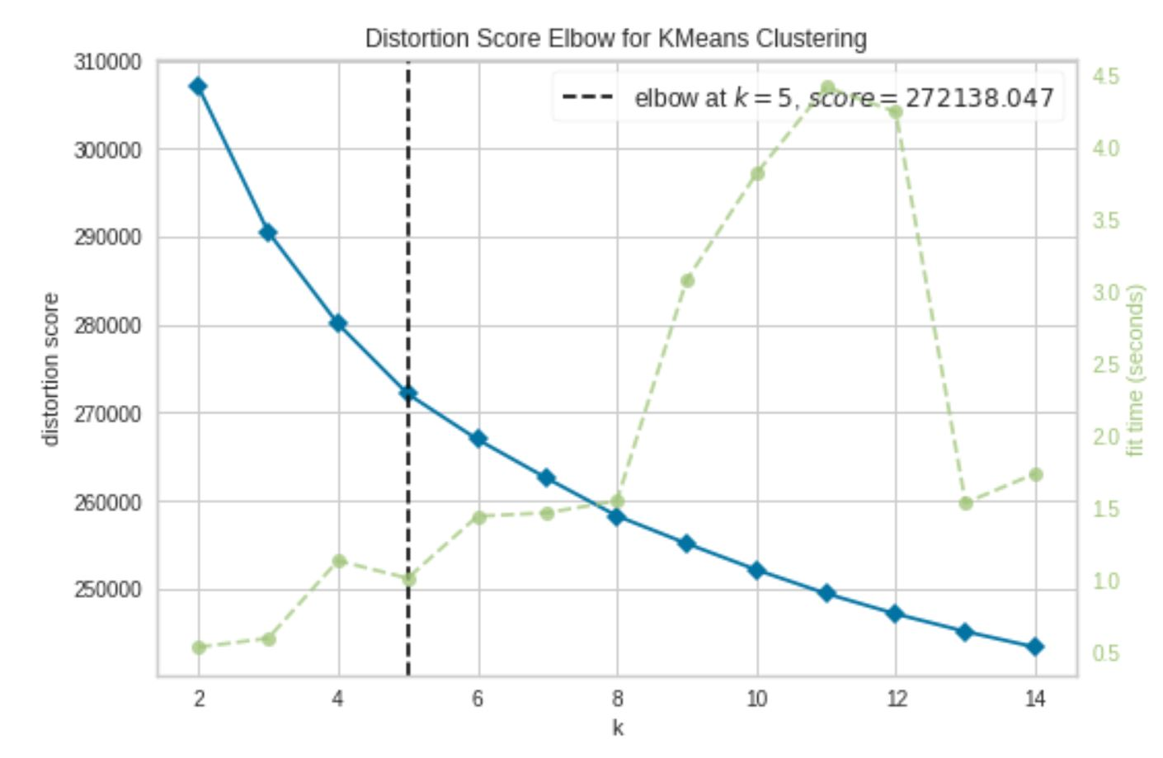
Clustering Continued
Elbow method used to determine number of clusters necessary.
Not a surprise, as this is based on the big 5.

Slide 17
Principal component analysis (PCA)
In order make each individuals’ questionnaire response a data point and graph it, I found that I needed to use PCA.
The data I am working with is hard to push all into 2D, since it is somewhat Five-dimensional. (Kinda hard to explain)
PCA allowed me to make each overall response a single point and create the clusters and graph it in a visually pleasing manner.

Slide 18
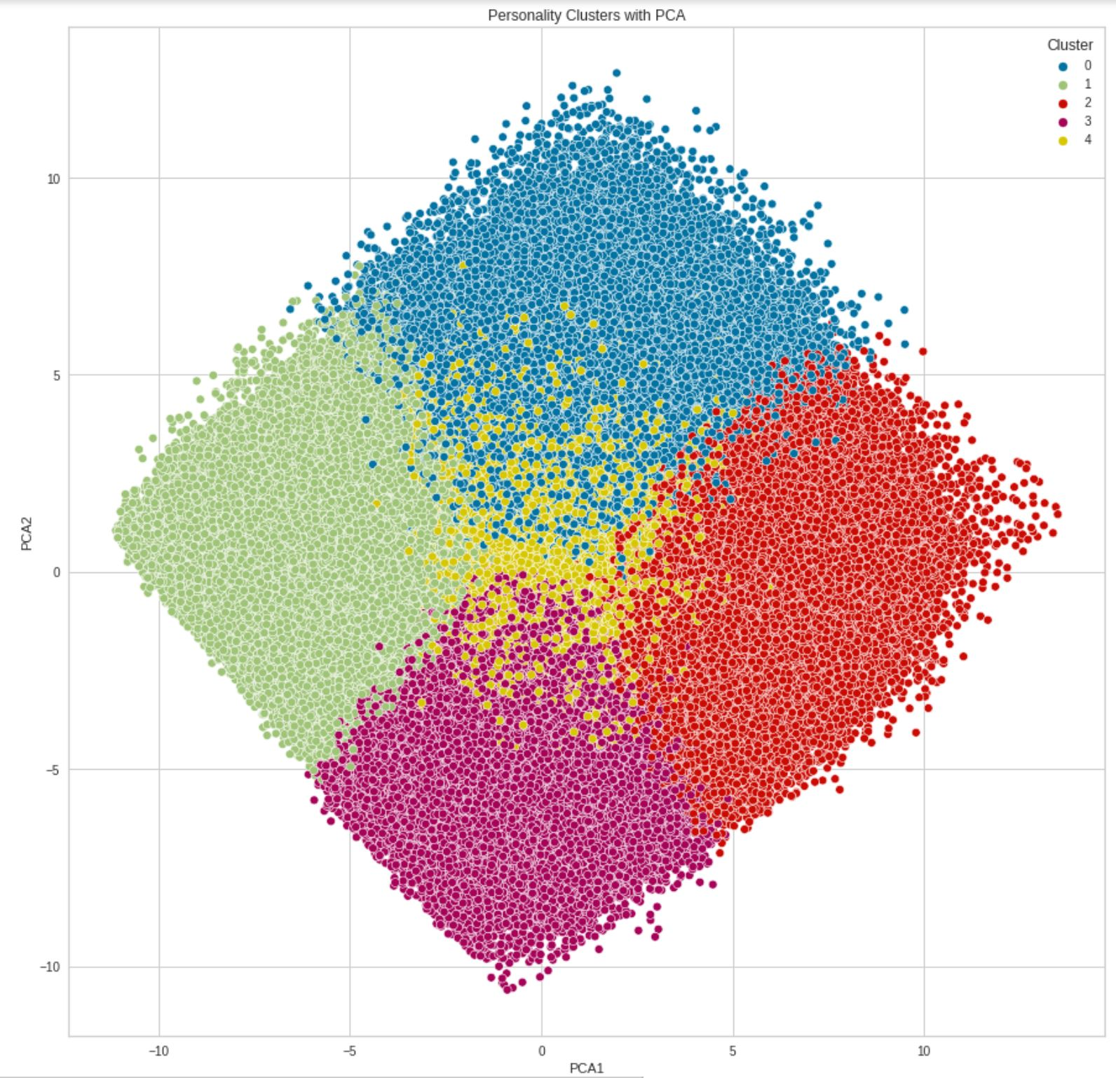

Slide 19
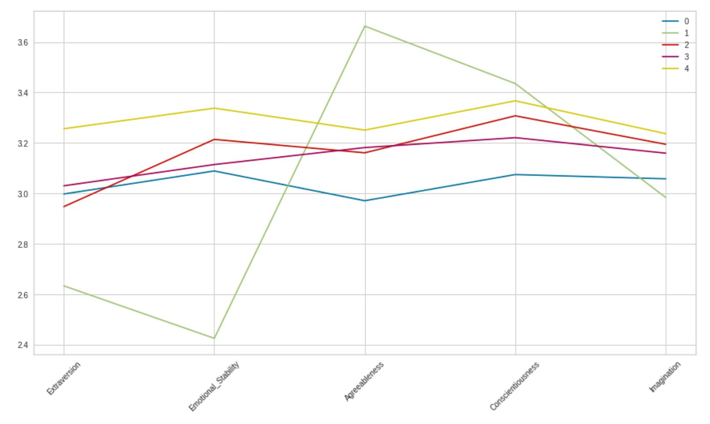
results
I was genuinely surprised by the result.
Expected all of the lines to be similar, but cluster 1 is very different than the rest.
Cluster 1 represents very introverted people who are less emotional, but are normally very polite or agreeable, very honest and hardworking, and have a bit of a smaller imagination due to seeing things as they truly are in the real world.

Slide 20
How did I do it?
Google Collab
416 MB dataset before compression (similar to MD car dataset I believe)
Necessary libraries for working with the data

Slide 21
Potential further work
So much more can be done!!!
Additional questions to survey:
GPA
Current Major
Desired Major
If enough students took this questionnaire, it could be used to help students select study habits and their major based on others who answered close to similarly to them.

